Slide 1
Task 14: Final Presentation

Slide 2
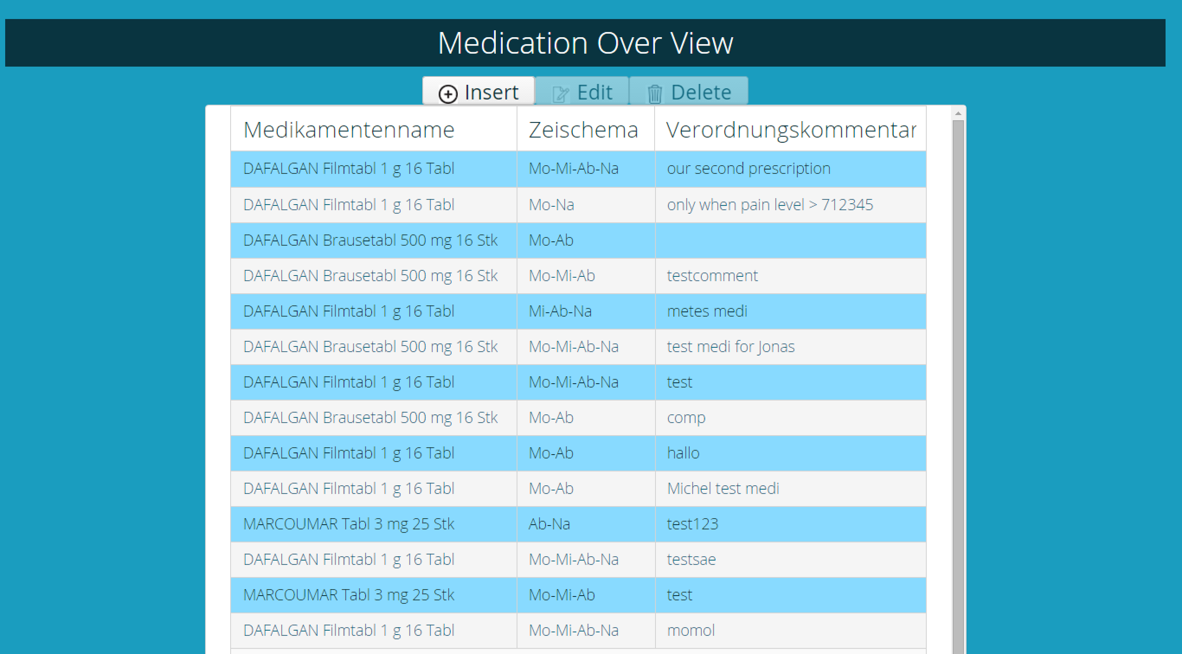
Demo

Slide 3
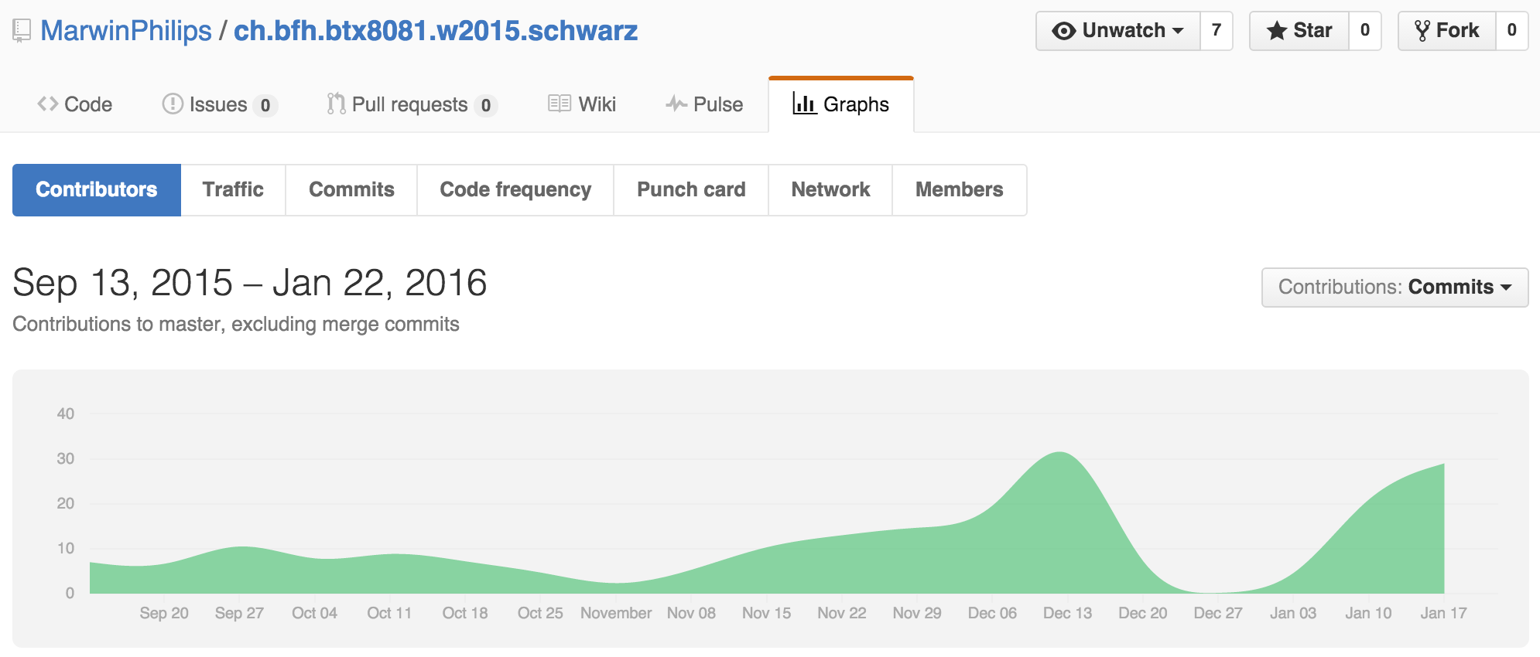
Contributions

Slide 4
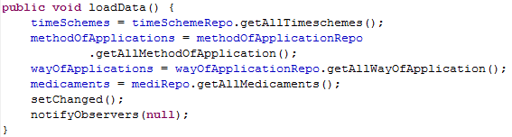
Contribution Mete Turna
Class: MedicationEditModel
Function: Read-, Edit- & Update Prescription
Methode: loadData()

Slide 5
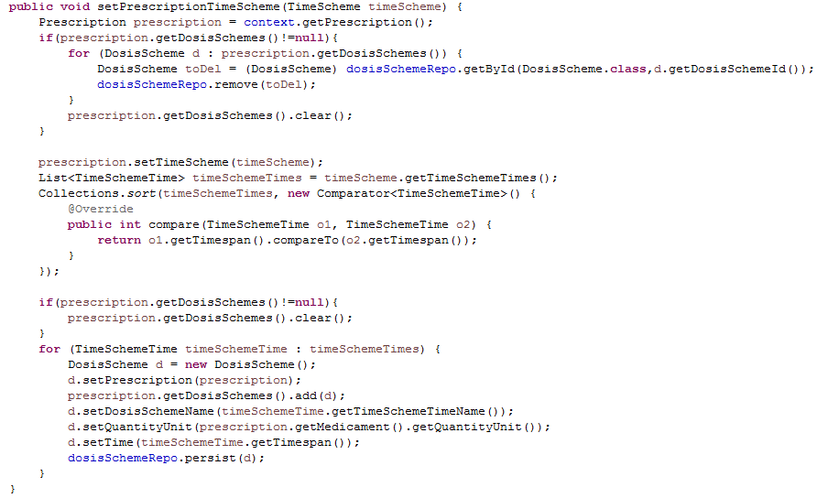
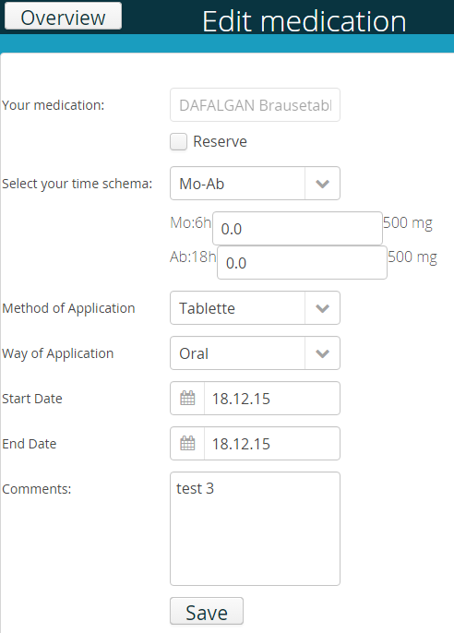
Contribution Mete Turna
PrescriptionTimeScheme

Slide 6
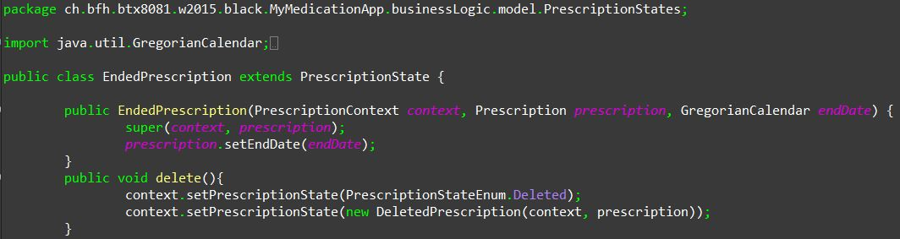
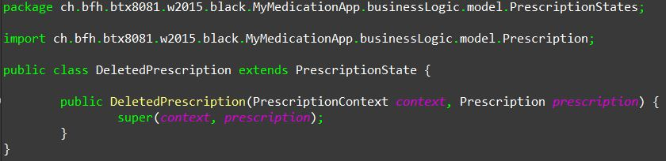
Contribution Michel Murbach
Deleting a new prescription
Call method

Slide 7
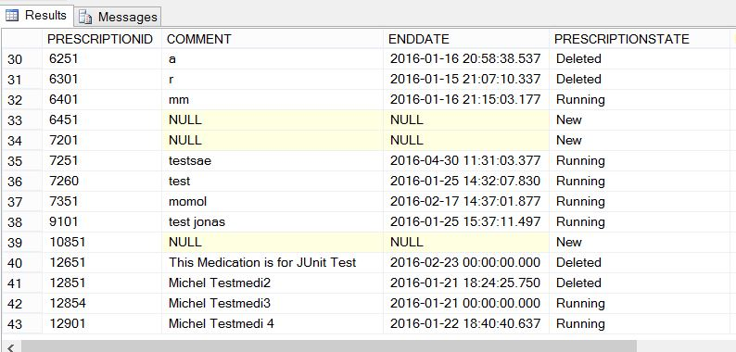
Contribution Michel Murbach
Deleting a new prescription

Slide 8
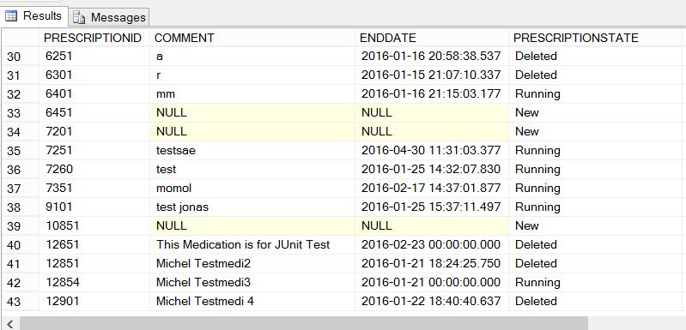
Contribution Michel Murbach
Deleting a new prescription

Slide 9
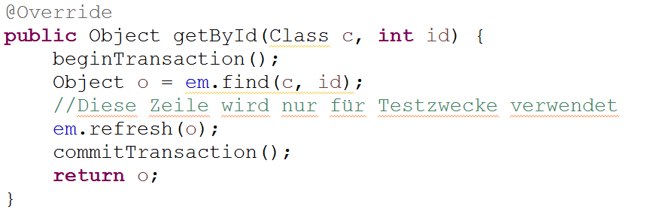
Contribution Carole Kaiser
Creating Overview of Medication
Styling all Element with mytheme.scss
Support / Pair Programming other Teammembers
Test Classes MsssqlRepository and PerscriptionRepository

Slide 10
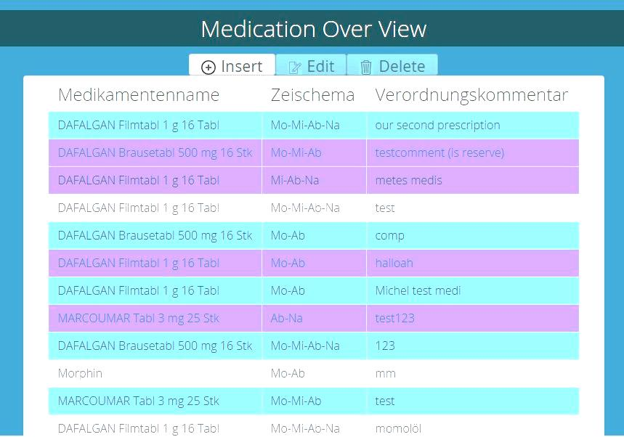
MedicationOverView (Amin)

Slide 11
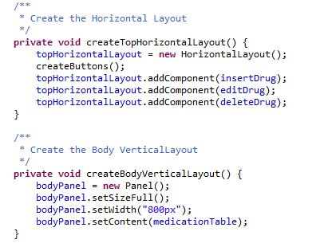
MedicationOverView

Slide 12
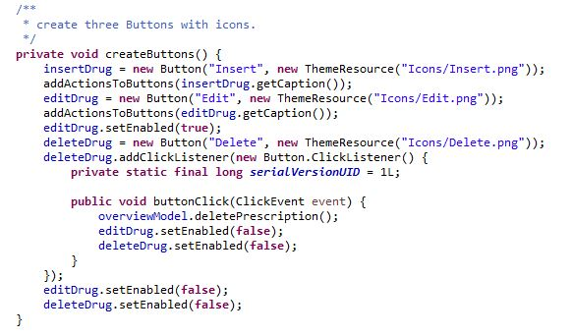
MedicationOverView

Slide 13
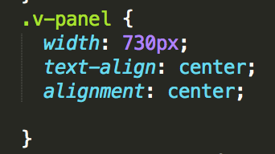
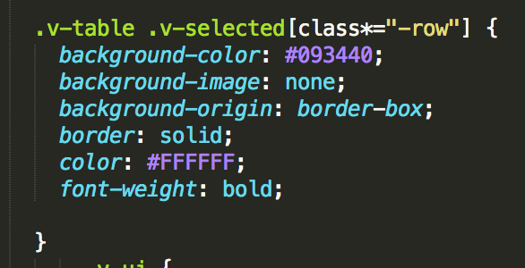
mytheme.scss

Slide 14

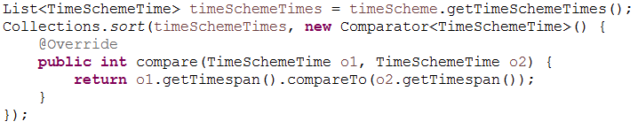
Contribution Marwin Philips
Database connectivity
General support for team members

Slide 15
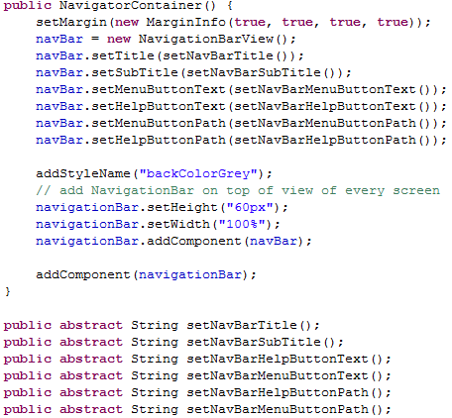
Contribution Jonas Mosimann
NavigationBar functionality
General Bugfixing / code review
Tests for validation
General support

Slide 16
Lessons learnt
team arrangement
not to many features
daily scrum-meetings is important
pair-programming was useful
knowhow-transfer via code reviews
storyboard & design is important
knowledge level

Slide 17
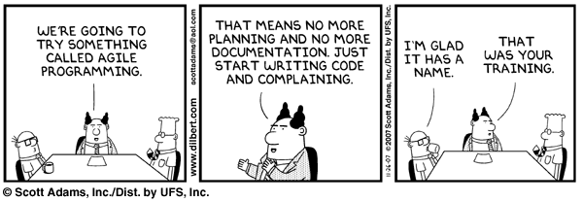
Questions

